Slide 1
Class 14:
Selfish Mining
Cryptocurrency Café
UVa cs4501 Spring 2015
David Evans

Slide 2
Plan for Today
Selfish Mining
Attacks on the Blockchain

Slide 5


Slide 6
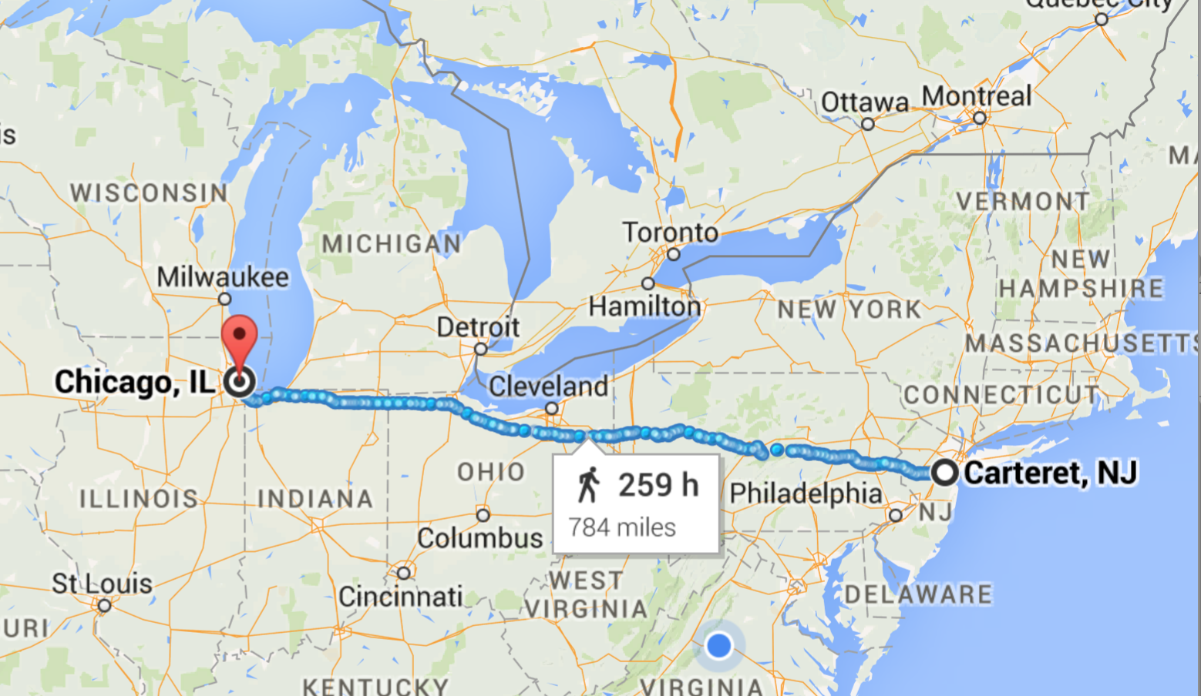

Slide 7
Normal network: 17 ms
Spread Networks ($300M): 13 ms
Chicago Mercantile Exchange
NASDAQ Data Center

Slide 8
Normal network: 17 ms
Spread Networks ($300M): 13 ms (827 miles)
Microwave Links: ~9 ms
1260 km / 299792 km/s = 4ms at lightspeed
Chicago Mercantile Exchange
NASDAQ Data Center

Slide 9
Pooling Miners
https://www.antpool.com/poolStats.htm

Slide 10
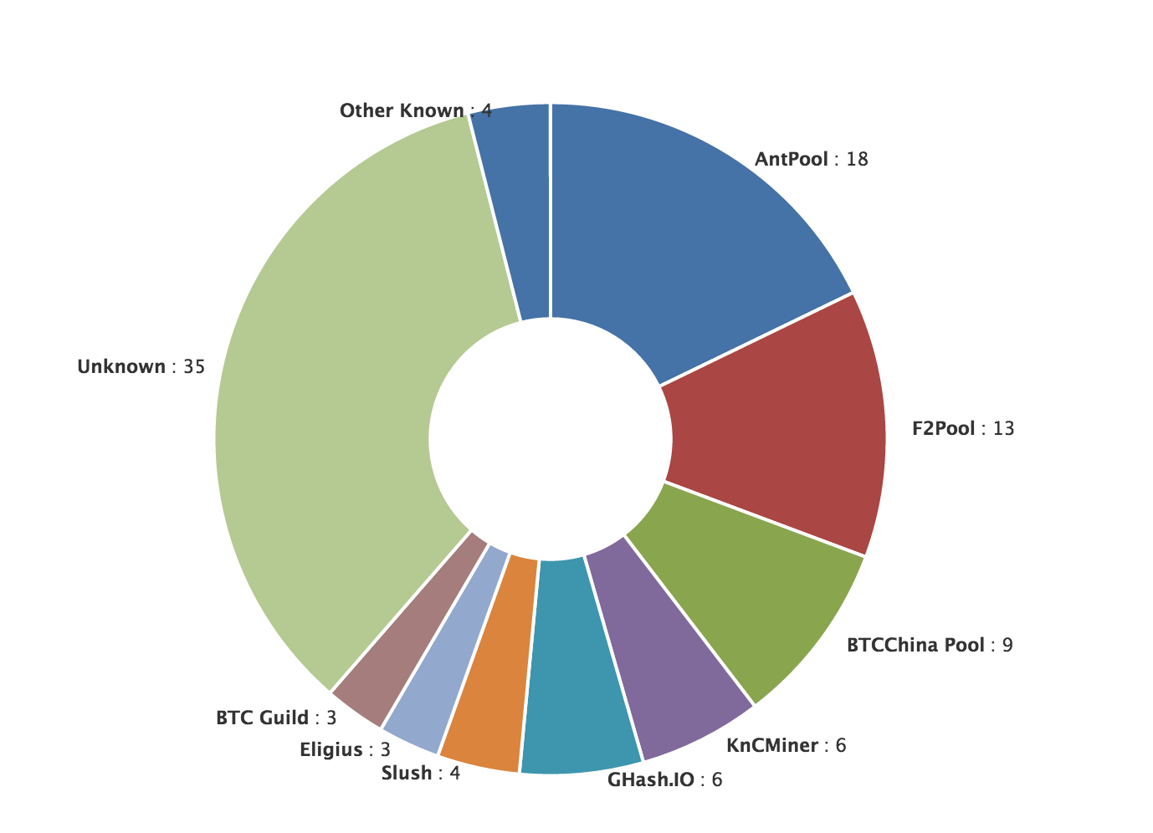
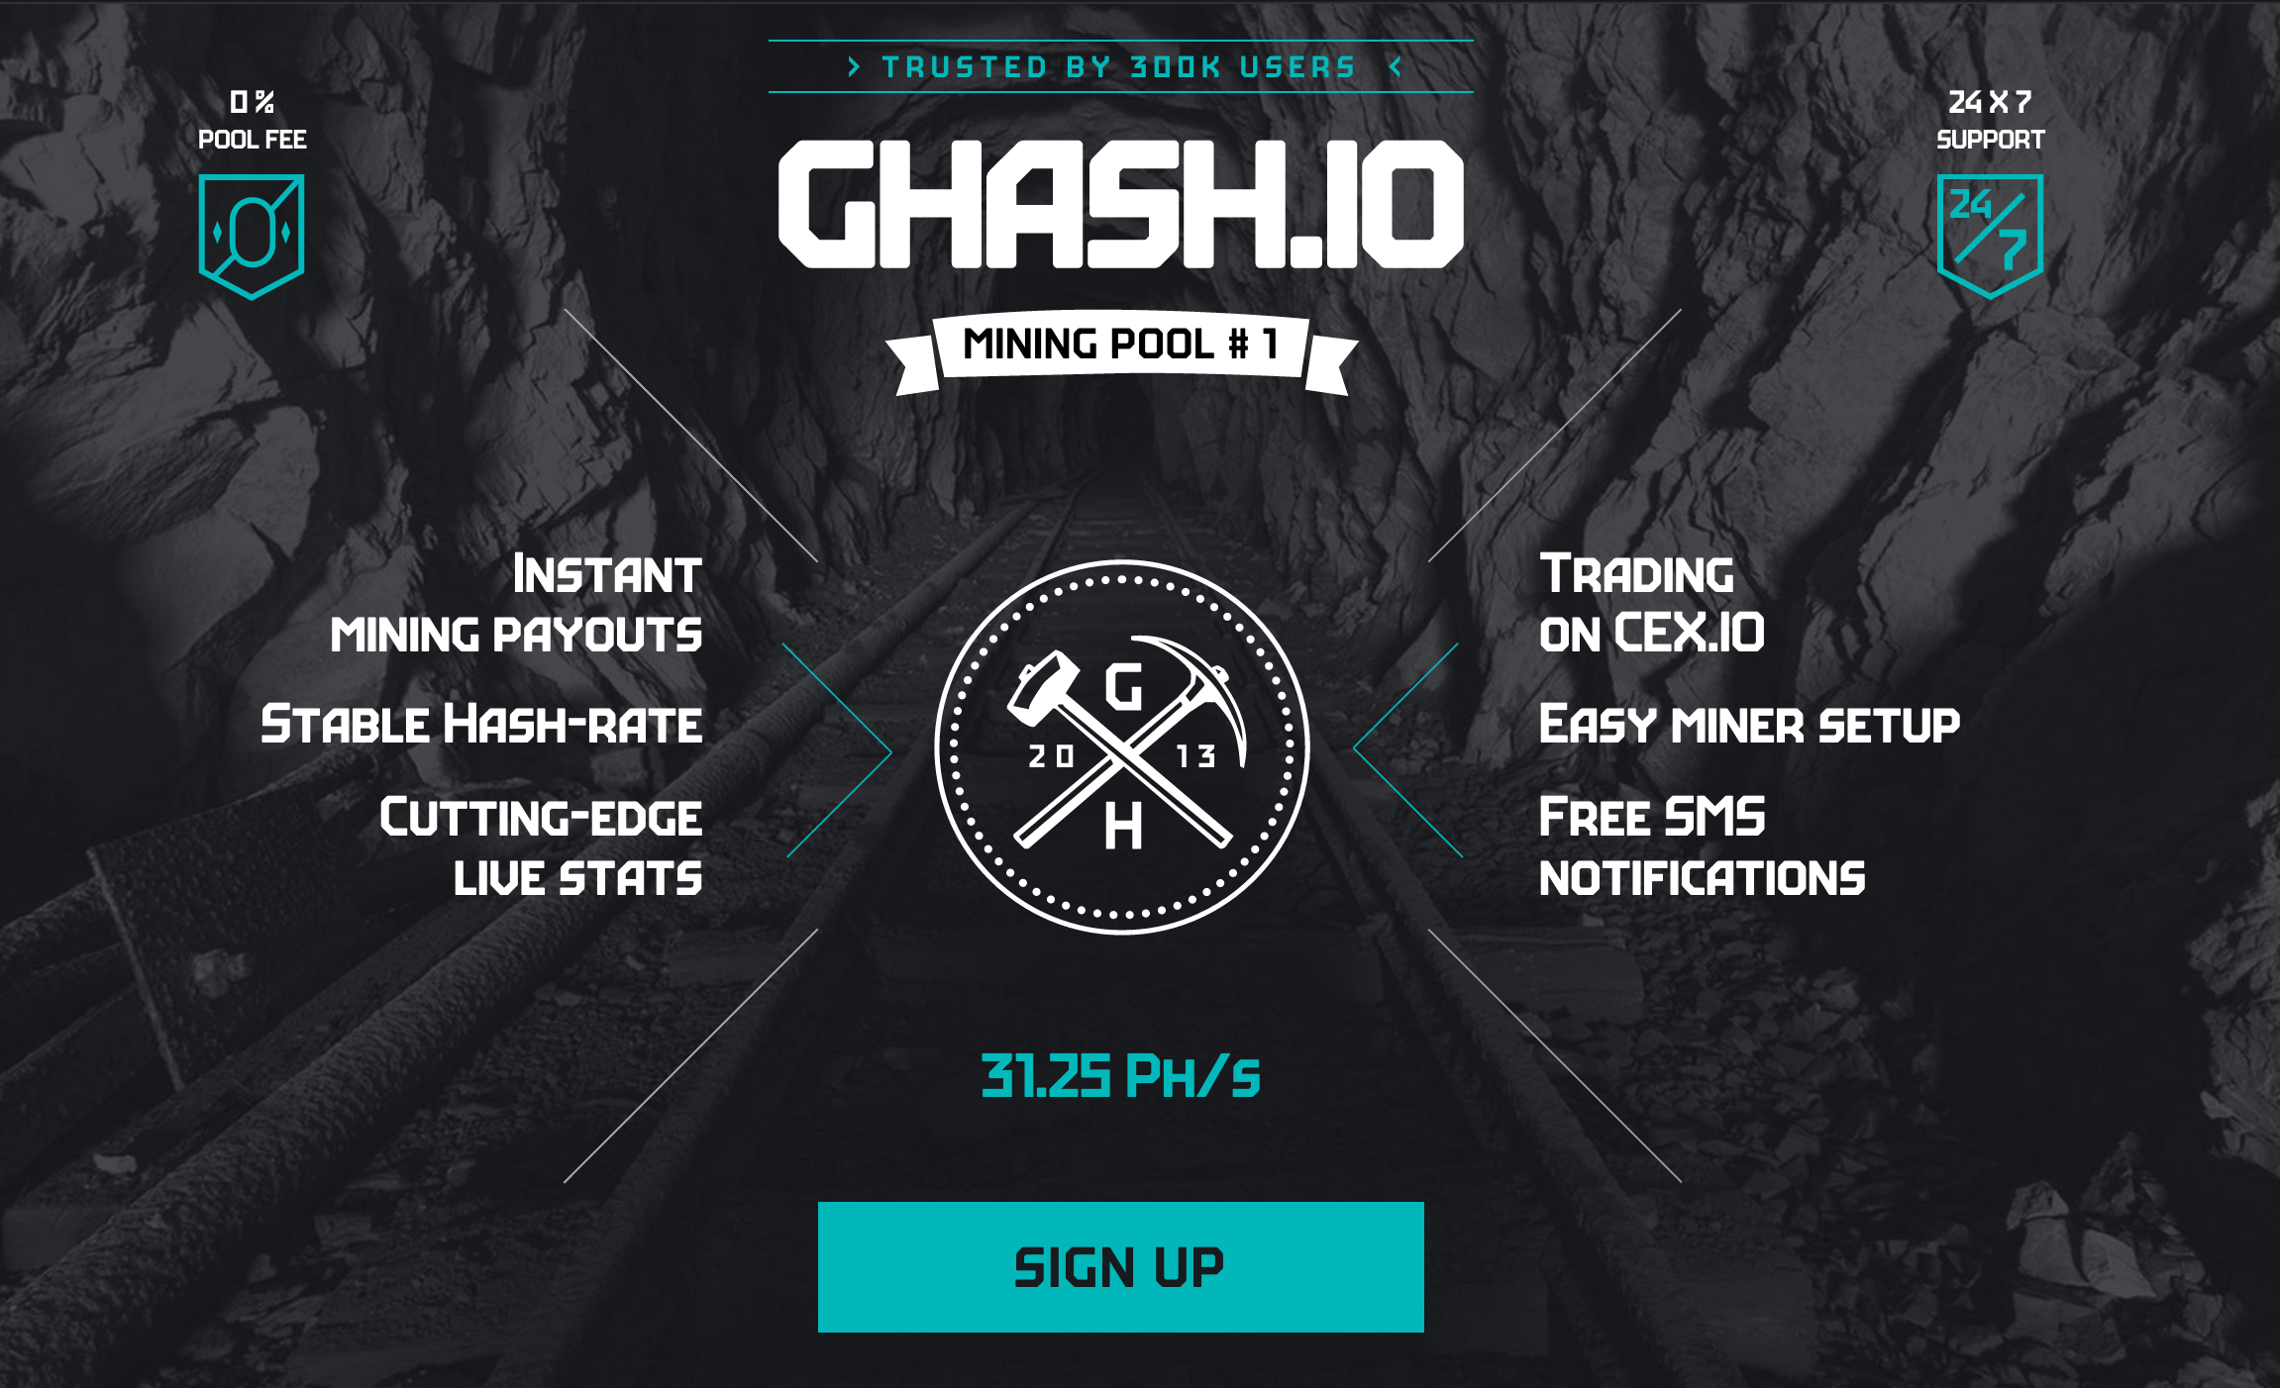
Mining Pool Dangers

Slide 11
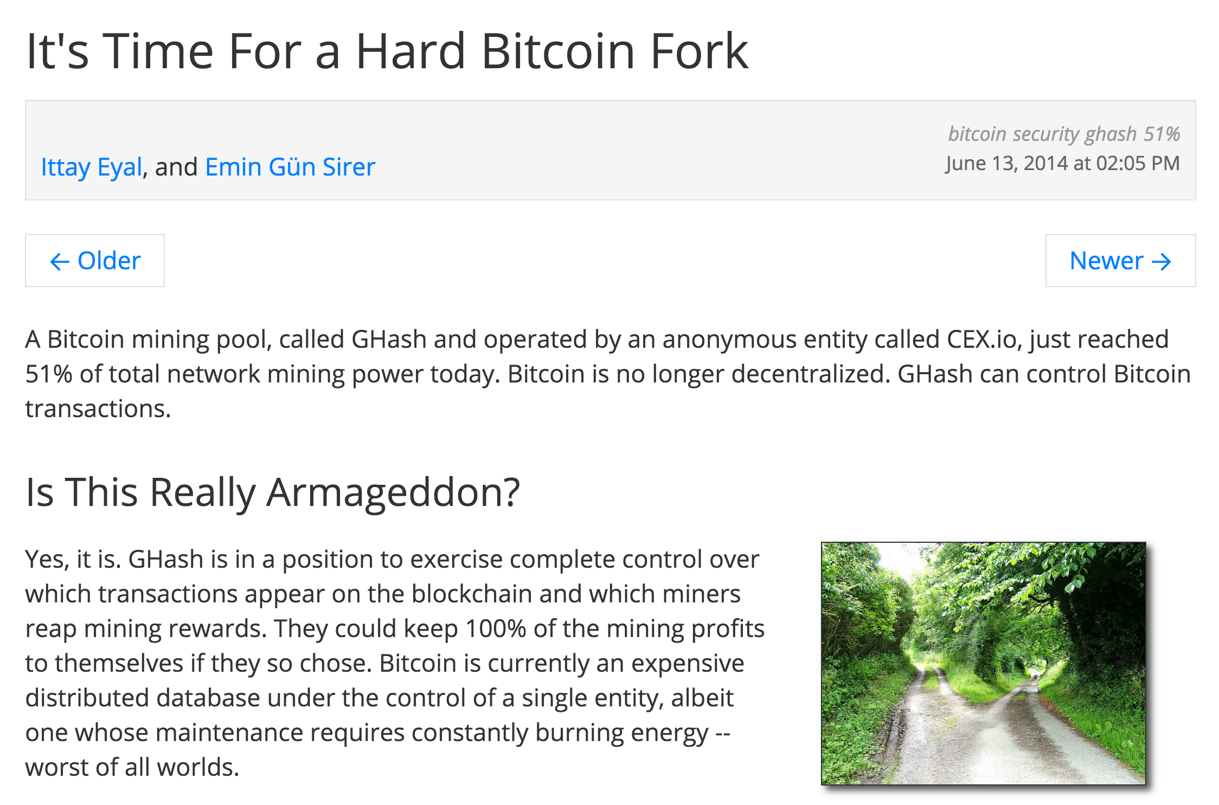

Slide 12
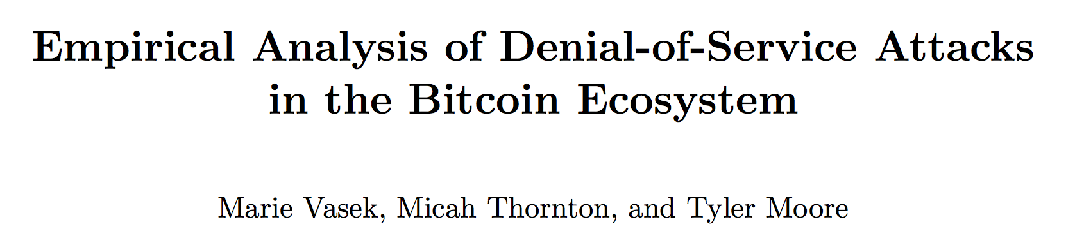
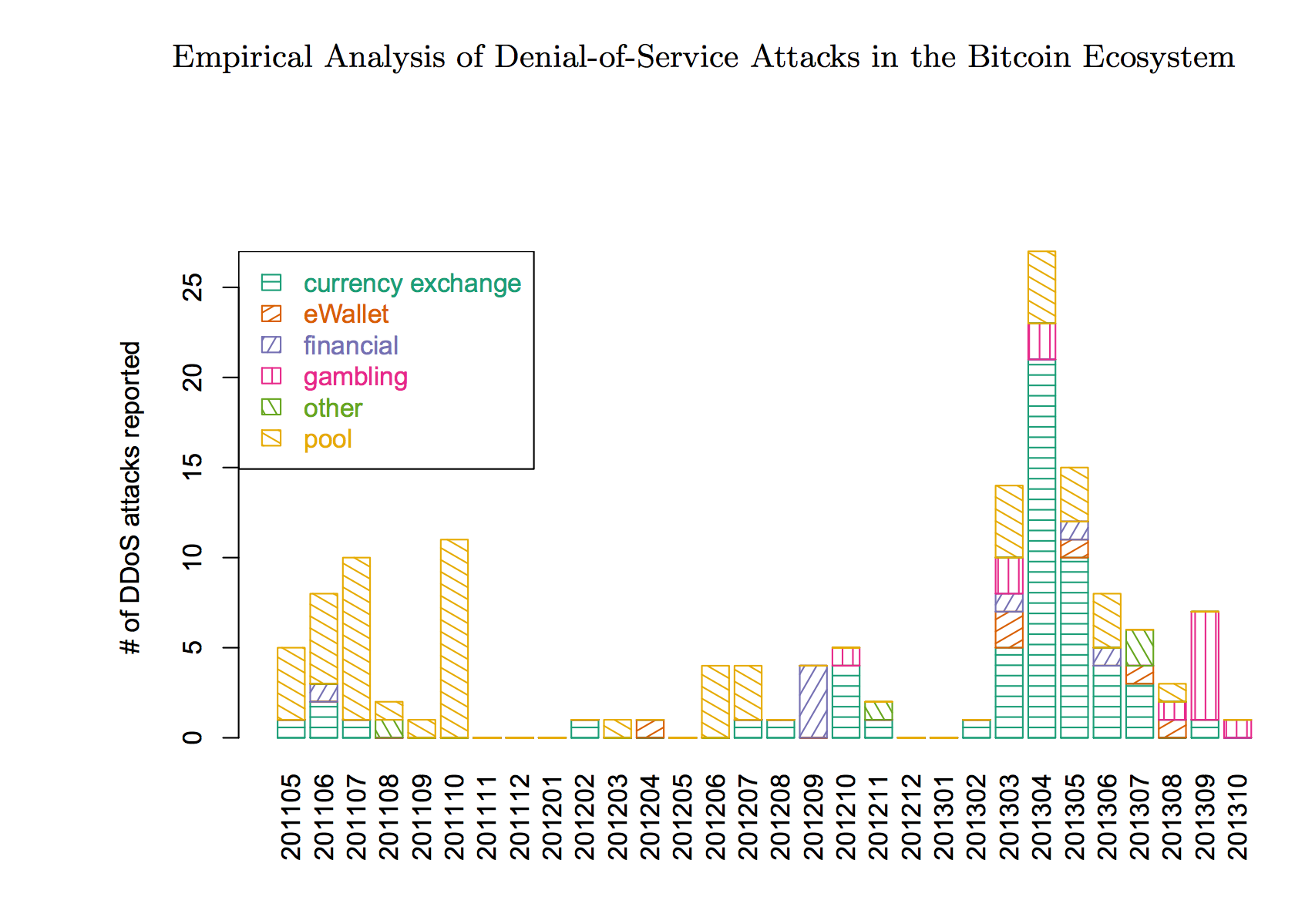
Mining Pool Attacks
DDOS-ing
Block Withholding
Lots of interesting questions about this and ongoing research…we’ll talk more in future classes. Many possible project ideas about mining pool dangers and attacks on mining pools.

Slide 13
Charge
Project 2 Part 2:
Due Thursday 5 March

